Slide 1
Agricultural Equipment Statistics Committee Product Definitions and Quick Links
TABLE OF CONTENTS
"Tractor and Implements" Product Line 6
FARM TRACTORS 6
Two Wheel Drive Tractors (FE01) 7
Four Wheel Drive Tractor (FE22) 7
Loader, Farm (front-end) (FE31) 8
Backhoe Attachment, Tractor (FEBA) 9
Flail Shredders (FEFS) 9
Box Scraper (formerly Land Leveler/Smoother) (FELL) 10
Post Hole Digger (FEPH) 11 Rigid Rotary Cutter (FER1) 11 Flexible Rotary Cutter (FER2) 12 Rigid Rear Mount Mower (FER3) 12 Flexible Rear Mount Mower (FER4) 13 Mower, Multi-Spindle Rotary Finishing (mid-mounted) (FERM) 13 Snow Blower (tractor mounted) (FESB) 14
Last revised 1/17/2023

Slide 2
Agricultural Equipment Statistics Committee Product Definitions and Quick Links
TABLE OF CONTENTS
Blade, Tractor (FETB) 15
"Forage and Harvest Equipment" Product Lines 16
Baler, Rectangular (FE35) 16
Baler, Round (FE36) 17
Combine, Self-Propelled (FE23) 18
Self-Propelled Shear Bar Harvester (FE27) 18
Loader, Farm (front-end) (FE31) 19
Corn Heads (FE52) 19
Mower, Drum, and Disk (FED1) 20 Combine Draper Head-Rigid (FEDR) 20 Combine Draper Head-Flexible (FEDX) 21 Forage Harvester Headers (FEFT) 21 Mower Conditioner, Rotary Side-Pull (FEM1) 22 Mower Conditioner, Rotary Mid-Pivot Front-Mounted or Multi-Unit (FEM2) 22 Mounted Mower Conditioner (FEM3) 23

Slide 3
Agricultural Equipment Statistics Committee Product Definitions and Quick Links
TABLE OF CONTENTS
Combine Pickup Headers (FEPC) 23
Combine Platform, Flexible Frame (FEPX) 24
Rotary Rakes (FERO) 24
Tedders (FETD) 25
Windrower/Swather Heads - Disk (self-propelled) (FEW2) 26
Windrower, Self-Propelled (FEW3) 27
Windrower/Swather Heads - Draper Type (self-propelled) (formerly Canvas Type) (FEWC) 27
Rake, Finger Wheel (FEWR) 28 "Crop Production Equipment" Product Line 29 Planter, Pull Type (FE15) 29 Planter, Mounted (FE16) 29 Light Duty Disk Harrow (FE57) 30 Pull-Type Disk Harrow (FE58) 30

Slide 4
Agricultural Equipment Statistics Committee Product Definitions and Quick Links
TABLE OF CONTENTS
Compact Disk (FECD) 31
Rotary Tillers (FER5) 31
Sprayer, Power (high-clearance) (FESP) 32
Strip Tillage (FEST) 33 Air Delivery System (TPA3) 33
Air Hoe Drill (TP14) 34
Air Disc Drill-Integrated (TP12) 35
Air Disc Drill-External (TP13) 36
Plows, Moldboard (TP53) 37
Plow, Combination Chisel (TPCC) 37 Plows, Chisel (TPCP) 38 Cultivator, Field (pull-type) (TPFP) 38 Three (3) Point Mounted Drills (TPG1) 39 Pull Type Rigid Drills (TPG2) 40 No-Till Drills (TPG3) 41 Grain Drill, Folding (TPGF) 42

Slide 5
Agricultural Equipment Statistics Committee Product Definitions and Quick Links
TABLE OF CONTENTS
Tillage, Minimum Primary (TPMP) 42
Tillage, Combination Primary (TPTP) 43
Tillage, Combination Secondary (TPTS) 43 Tillage, Vertical (TPVT) 44
Ag Precision Guidance 45 Receivers (PG01) 45 Steering Kits (PG02) 45 Activation Upgrades (PG03) 45 Displays (PG04) 45 FEEV (Ag Equipment Value) 46

Slide 6
FARM TRACTORS
AESC PRODUCT DEFINITIONS
“Tractor and Implements” Product Line
A self-propelled wheeled or tracked machine, designed primarily to provide tractive power to pull, push, carry and/or provide power to implements designed primarily for agricultural usage. Agricultural tractors have 7.5 Kw (10hp) or more net engine horsepower per Society of Automotive Engineers Standard J1349, Engine Test Code-Spark Ignition and Diesel. (Source: ASAE Yearbook of Standards)
In addition, farm tractors have one or more of the following characteristics:
1. ASAE 3-point hitch with position control - category 1 or above
2. ASAE 540 rpm PTO, or larger, transmission (dual clutch or independent)
PTO horsepower is defined as maximum power obtained at the rated engine speed specified by the manufacturer with the governor control set for maximum power.

Slide 7
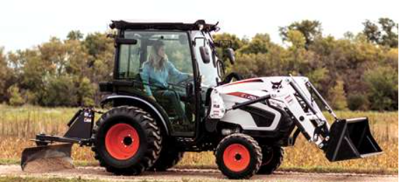
Two Wheel Drive Tractors (FE01)
AESC PRODUCT DEFINITIONS
Typically have larger tires mounted on the rear and smaller tires mounted on the front. Front wheel assist (FWA) tractors would typically incorporate larger front tires than two-wheel drive tractors. Exceptions to this definition and included in the two-wheel drive farm tractor data are the row crop tracked unit models and Orchard and Vineyard, as approved by the Agricultural Equipment Statistics Committee. The row crop tracked unit design is typically lighter, with a narrower stance and narrower track width than that of a non-row crop designed track unit and is a fixed frame tractor.
Reporting Classifications: by Advertised PTO horsepower (N chart) and Advertised Rated Engine horsepower (O chart)
Four Wheel Drive Tractor (FE22)
Further defined as a large frame machine with equal size wheels with the capability to dual/triple all wheel; equal and consistent power to all wheels; full time power to all wheels; engages primarily in heavy draft and drawbar applications normally considered to be related to farming; all wheel steer; and articulated or rigid frame. Exceptions to this definition and included in the four-wheel drive farm tractor data are the non-row crop tracked unit models. The non-row crop tracked unit design is typically heaver, with a wider stance and wider tracks than that of the row crop designed track unit and can be a fixed frame tractor.
Reporting Classifications: by Advertised Rated Engine horsepower

Slide 8
Loader, Farm (front-end) (FE31)
AESC PRODUCT DEFINITIONS
An attachment for various farm tractor models to lift and load many different types of materials. The loader attachment can be powered by the tractor hydraulic system or an optional auxiliary hydraulic system. Various attachment options to handle different products can usually be interchanged with a normal loader bucket. The loader may be a quick-detach model or one that permanently attaches to a tractor. A loader that is designed to be an integral part of a tractor's primary use would not be included in this category because it wouldn't be considered an attachment to the primary power source.
Reporting classifications: by PTO horsepower of tractor which loader attachment is designed to fit and Lift Capacity at maximum height at the pivot pin.

Slide 9
Backhoe Attachment, Tractor (FEBA)
AESC PRODUCT DEFINITIONS
Tractor backhoe attachments are backhoes that may be attached to the tractor's 3 pt. hitch or attached to the tractor by way of a subframe attaching system or some other attaching system.
Reporting classifications: by digging depth (flat bottom) in feet.
Flail Shredders (FEFS)
A PTO driven attachment with several knives or blades that spin on a horizontal axis to shred crop residue. These attachments are used in crops such as corn, milo, rice, grasses, potatoes, vegetables, etc. This includes both end drive and center driven units. Unit is either mounted on or pulled by a tractor and is positioned directly behind a tractor.
Reporting classifications: by feet

Slide 10
Box Scraper (formerly Land Leveler/Smoother (FELL)
AESC PRODUCT DEFINITIONS
An implement that is pulled behind the 3-point hitch system of an agricultural or industrial tractor. The primary use is to smooth out rough terrain or material in landscaping or construction. Different types of levelers/smoothers are used to level out roads and irrigated fields. The "box" design of a leveler/smoother has a main crossbeam which provides the strength and base support of the implement. The crossbeam usually has scarifier shanks attached to break up the soil followed by a cutting edge designed to cut or smooth out the surface. A hinged or fixed backfill blade is attached to the rear of the implement for additional smoothing of materials in the forward operations and when the unit is reversed, and the blade stops for backfilling. Also known as a "land leveler/smoother".
Reporting classifications: all sizes

Slide 11
Post Hole Digger (FEPH)
AESC PRODUCT DEFINITIONS
An attachment powered by mechanical power take-off or hydraulic fluid to drill holes in earthen soil or rock.
Reporting classification: all sizes
Rigid Rotary Cutter (FER1)
A single rigid deck construction rough-cut mower, employing horizontal rotating knives to cut or shred grass, brush or crop residue. The rigid rotary cutter may be hitch mounted or pull-type from tractor. Powered by tractor PTO, tractor hydraulics system or mounted engine.
Reporting classifications: by size of cutting swath in inches.

Slide 12
Flexible Rotary Cutter (FER2)
AESC PRODUCT DEFINITIONS
A flexible, multi deck construction rough-cut mower, employing horizontal rotating knives to cut or shred grass, brush or crop residue. The flexible rotary cutter may be hitch mounted or pull-type from tractor. Powered by tractor PTO, tractor hydraulics system or mounted engine.
Reporting classifications: by size of cutting swath in inches.
Rigid Rear Mount Mower (FER3)
A single rigid deck construction finishing mower, employing horizontal rotating multi blades implement used for fine or finish mowing in lawn, turf and grounds keeping applications. The rigid finishing mower may be hitch mounted or pull-type (not mid-mounted) from tractor. Powered by tractor PTO, tractor hydraulics system or mounted engine.
Reporting classifications: by size of cutting swath in inches.

Slide 13
Flexible Rear Mount Mower (FER4)
AESC PRODUCT DEFINITIONS
A flexible, multi deck construction finishing mower, employing horizontal rotating multi blades implement used for fine or finish mowing in lawn, turf and grounds keeping applications. The flexible finish mower may be hitch mounted or pull-type from tractor. Powered by tractor PTO, tractor hydraulics system or mounted engine.
Reporting classifications: by size of cutting swath in inches.
Mower, Multi-Spindle Rotary Finishing (mid-mounted) (FERM)
A mower which employs multiple horizontal rotating blades for fine or finishing mowing in lawn, turf and grounds keeping applications. Implement is mid- or under-mounted. Mower is carried between the tractor or power unit's front and rear axles. Power may be supplied by tractor PTO or hydraulic system.
Reporting classifications: by size of cutting swath in inches.

Slide 14
Snow Blower (tractor mounted) (FESB)
AESC PRODUCT DEFINITIONS
A machine that may be attached to agricultural tractors (to the front or rear 3 point hitch of the tractor), or other types of self-propelled machines (power units), that is designed to move snow. Snow blowers may be powered by hydraulic motors or by tractor's power-take-off shaft. Snow blowers can have one auger, or multiple augers stacked on top of another, that move snow to the center to a fan behind the auger that propels and directs snow, by way of a chute, to where it is to be deposited in an adjacent space or in a truck. Common widths for snow blowers are between 4 feet and 9 feet.
Reporting classifications: all sizes

Slide 15
Blade, Tractor (FETB)
AESC PRODUCT DEFINITIONS
An implement that is either pushed or pulled behind the 3 point hitch system of an agricultural or industrial tractor. The primary use is to move material from one place to another or to smooth out rough terrain in landscaping or light industrial construction. The design is a basic blade or moldboard attached to a mounting frame. Blade can be angled to move material from one side to another. Rear blades have reverse adjustments allowing 180 degrees of rotation. Front blades contain a spring trip design to allow blade pivot to avoid damage when encountering obstructions.
Reporting classifications: by front or rear mount

Slide 16
Baler, Rectangular (FE35)
AESC PRODUCT DEFINITIONS
“Forage and Harvest Equipment” Product Lines
Self-propelled or pull-type machine that compresses previously cut, dried or otherwise cured materials (i.e. hay, grass, straw, corn stalks, etc.) materials in a distinct square or rectangular shaped chamber using a pitman and plunger head. Contains a self-feeding device, which is mechanically operated, and timed so that when the plunger is retracted, the feeder forces the dried materials into one or more distinct baling chambers. The bale is then mechanically tied by some means (i.e., twine tie or wire tie).
Conversion from Metric to Imperial/US Standard measurements are as follows:
1 Millimeter = 0.0393701 Inches and 1 Inch = 25.4 Millimeters
Reporting classifications:
1.) By measurement of the width of the distinct bale chamber in millimeters rounded to the nearest tenth and the maximum height of the distinct bale chamber in millimeters rounded to the nearest tenth.
2.) Entries will be reported by nominal bale size with the first numeral indicating the nominal width in feet, a second fixed character “X”, and the third numeral indicating the nominal height in feet.
a.) Balers having a distinct chamber height and width both measuring less than or equal to
560.0 mm (22 in.) will be sized by text as “small square” models.
b.) Balers having a distinct chamber height and width both measuring
<= 875.0 mm (34.44 in.) will be sized by text as “3x2” models.
c.) Balers having a distinct chamber height and width both measuring
<= 950.0 mm (37.40 in.) mm will be sized by text as “3x3” models.
d.) Balers having a distinct chamber height and width both measuring
<= 1250.0 mm (49.21 in.) will be sized by text as “3x4” models.
e.) Balers having a distinct chamber height or width measure > 1250.0 mm (49.21 in.)
will be sized by text as “4x4+” models.

Slide 17
Baler, Round (FE36)
AESC PRODUCT DEFINITIONS
Self-propelled or pull-type machine that rolls previously cut, dried or otherwise cured materials (i.e., hay, grass, straw, corn stalks, etc.) into a continuous stream. Material is compressed into a large round bale by belts, chains, or rollers. The bale is then tied by some means (i.e., twine tie or net wrap) the machine opens and ejects the bale from the chamber. Entries into this program must produce a bale size width wider than 1143.0 mm (45 in.) and taller than 1143.0 mm (45 in.) to be considered.
Conversion from Metric to Imperial/US Standard measurements are as follows:
1 Millimeter = 0.0393701 Inches and 1 Inch = 25.4 Millimeters
Reporting classifications:
1.) By measurement of the of the narrowest width of the bale chamber in millimeters rounded to the nearest tenth and the maximum height of the bale chamber (Maximum bale diameter) in millimeters rounded to the nearest tenth.
2.) Entries will be reported by nominal bale size with the first numeral indicating the nominal width in feet, a second fixed character “X”, and the third numeral indicating the nominal height in feet.
a.) Balers having a chamber width measuring <= 1300.0 mm will be sized by text as
“4-foot-wide” models and further segmented by chamber height.
i.) 4 x 4 Bale chamber height measuring <= 1300.0 mm (51.18 in.)
ii.) 4 x 5 Bale chamber height measuring <= 1570.0 mm (61.81 in.)
iii.) 4 x 5.5 Bale chamber height measuring <= 1700.0 mm (66.92 in.)
iv.) 4 x 6 Bale chamber height measuring > 1700.0 mm (66.92 in.)
b.) Balers having a chamber width measuring > 1300.0 mm or more be sized by text as
5-foot-wide models and further segmented by chamber height.
i.) 5 x 5 Bale chamber height measuring <= 1700.0 mm (66.92 in.)
ii.) 5 x 6 Bale chamber height measuring > 1700.0 mm (66.92 in.)

Slide 18
Combine, Self-Propelled (FE23)
AESC PRODUCT DEFINITIONS
Integral engine-powered machine designed to harvest a wide variety of field grain, rice, field beans or dry peas, oil seed and grass seed crops. These machines incorporate either a crop cutting or gathering device, a threshing method, and grain holding capability. This category does not include harvesters of certain root crops.
Reporting classifications: by ISO gross engine kilowatts at rated engine speed, excluding power bursts/bulges, fans, and alternators (ISO 14396)
Self-Propelled Shear Bar Harvester (FE27)
A machine commonly known as Self-Propelled Forage Harvester, which is designed to precisely chop crops using a stationary shear bar and rotating knife cylinder. The chopped crop is ejected by an impeller through a chute into a truck or trailer. The Self-Propelled Forage Harvester can be operated with different header attachments for different crops or applications. Most common attachments are corn heads, pickup heads and direct-cut heads. In some cases, the machines may also be used with special heads for the harvest of renewable resources or biofuels like small trees and other crops.
Reporting Classifications: self-propelled models are reported as Gross Engine Horsepower. Pull-type models are based upon class of design.

Slide 19
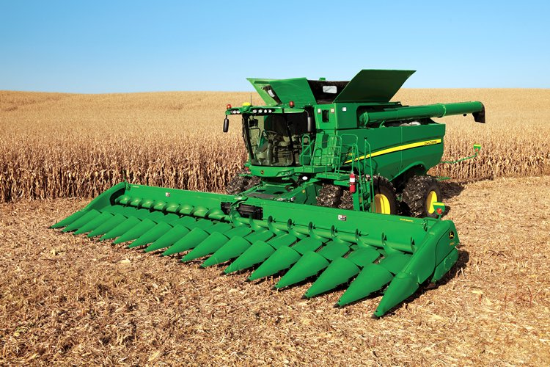
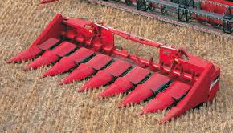

Loader, Farm (front-end) (FE31)
AESC PRODUCT DEFINITIONS
An attachment for various farm tractor models to lift and load many different types of materials. The loader attachment can be powered by the tractor hydraulic system or an optional auxiliary hydraulic system. Various attachment options to handle different products can usually be interchanged with a normal loader bucket. The loader may be a quick-detach model or one that permanently attaches to a tractor. A loader that is designed to be an integral part of a tractor's primary use would not be included in this category because it wouldn't be considered an attachment to the primary power source.
Reporting classifications: by PTO horsepower of tractor which loader attachment is designed to fit and Lift Capacity at maximum height at the pivot pin.
Corn Heads (FE52)
A gathering unit for self-propelled combines used to harvest standing rows of eared corn. These are usually interchangeable attachments having either fixed or adjustable row width capability.
Reporting classifications: by number of rows

Slide 20
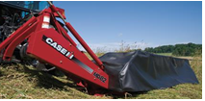
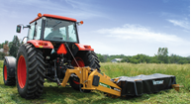
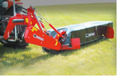
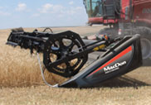
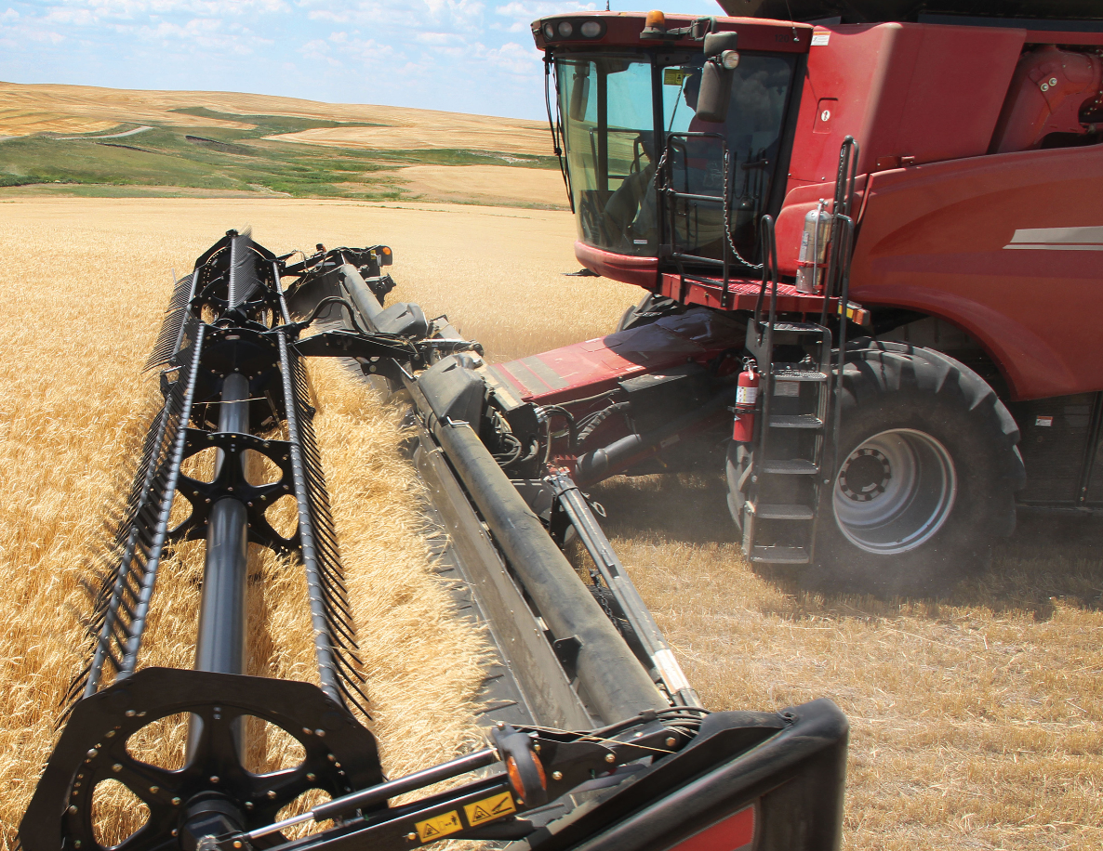
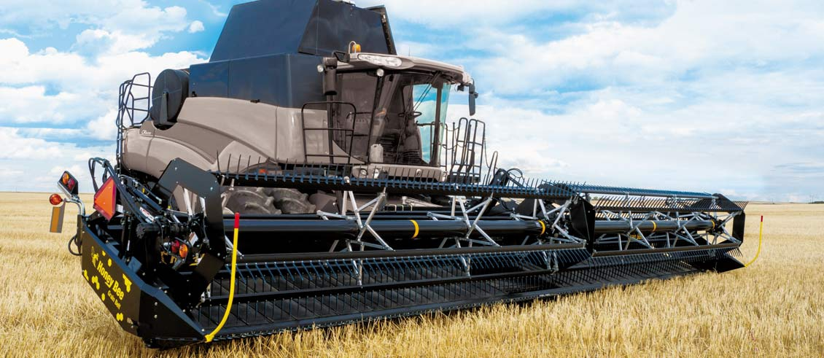
Mower, Drum and Disk (FED1)
AESC PRODUCT DEFINITIONS
A mower which employs a series of rotating blade carriers for cutting grass, hay or forage crops. Implements may be mounted or pull-type, driven by farm tractor PTO or hydraulic system.
Reporting classifications: cutting width in feet end of disc to end of disc
Combine Draper Head-Rigid (FEDR)
A crop gathering unit for combines with rigid frame, designed to collect and transfer crop into the threshing area. Cut crop is conveyed to the feederhouse opening by draper-type belts.
Reporting classifications: by cutting width of crop area in feet

Slide 21
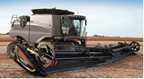
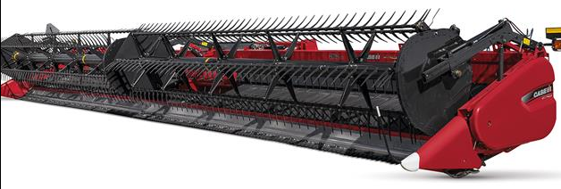
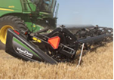
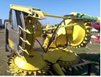
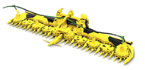
Combine Draper Head-Flexible (FEDX)
AESC PRODUCT DEFINITIONS
A crop gathering unit for combines with a flexible frame, designed to collect and transfer crop into the threshing area. Cut crop is conveyed to the feederhouse opening by draper-type belts.
Reporting classifications: by cutting width of crop area in feet
Forage Harvester Headers (FEFT)
Detachable/interchangeable crop gathering header devices for specific types of forage crops, either to directly cut standing crop or to pick up previously cut crop. Headers for this category should be for use with self-propelled forage harvesters. Pull-type forage headers should not be included.
Reporting Classifications: by design type

Slide 22
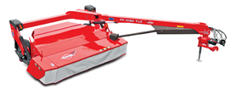
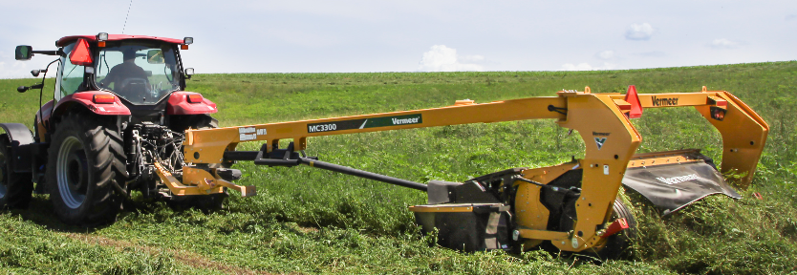
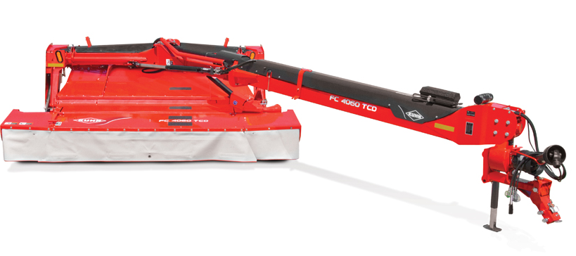
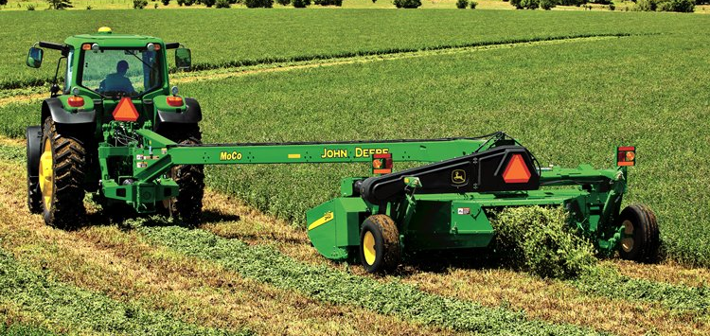
Mower Conditioner, Rotary Side-Pull (FEM1)
AESC PRODUCT DEFINITIONS
A machine powered by an agricultural tractor with power take off (PTO), which cuts grass, hay or forage crop by means of a series of rotating discs or cylinders, each holding multiple knives. Crop passes through horizontally positioned conditioning rolls, or through rotating flails and the machine deposits the cut and conditioned crop in a swath or windrow on the ground behind the unit. The unit is pulled by the tractor and positioned to operate on only one side of the tractor.
Reporting classifications: by cutting width in meters or feet & inches and then converted to meters
Mower Conditioner, Rotary Mid-Pivot Front-Mounted or Multi Unit (FEM2)
A machine powered by an agricultural tractor with power take off (PTO), which cuts grass, hay or forage crop by means of a series of rotating discs or cylinders, each holding multiple knives. Crop passes through horizontally positioned conditioning rolls, or through rotating flails and the machine deposits the cut and conditioned crop in a swath or windrow on the ground behind the unit. The unit is pulled by the tractor and has a mid-pivot device that allows it to operate on either side of the tractor.
Reporting classifications: by cutting width in meters or feet & inches and then converted to meters.

Slide 23
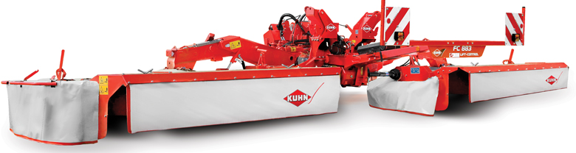
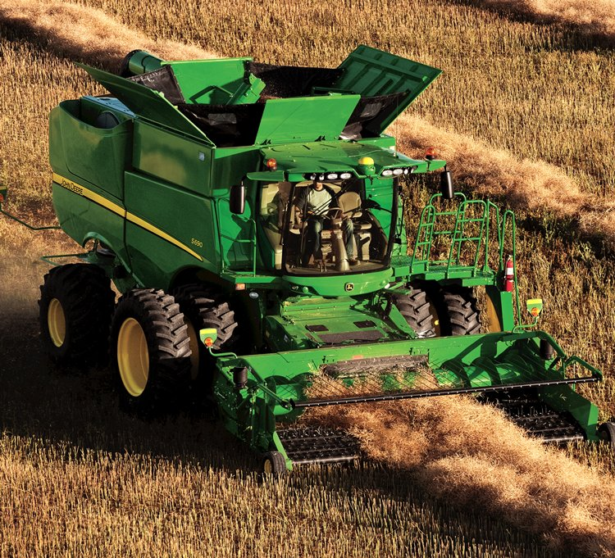
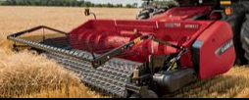
Mounted Mower Conditioner (FEM3)
AESC PRODUCT DEFINITIONS
A machine powered with power take off (PTO), that is mounted on an agricultural tractor or a self-propelled forage harvester chassis, which cuts grass, hay or forage crop by means of a series of rotating discs or cylinders, each holding multiple knives. Crop passes through horizontally positioned conditioning rolls, or through rotating flails and the machine deposits the cut and conditioned crop in a swath or windrow on the ground behind the unit(s). Units can be positioned to operate on the front individually, to the rear individually, to the rear when used with a reverse-station tractor, or in combinations of the front and rear simultaneously. Individual units are carried by the front and/or rear three-point hitch of an agricultural tractor, attached to a purpose built-self-propelled unit designed expressly for this purpose or adapted to a self-propelled forage harvester chassis.
Reporting classifications: by cutting width in meters or feet & inches and then converted to meters
Combine Pickup Headers (FEPC)
A device consisting of a frame, auger and tined apparatus which attaches to the front end of a threshing unit to pick up previously cut and windrowed material.
Reporting classifications: all sizes

Slide 24
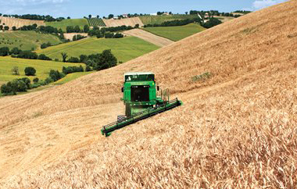
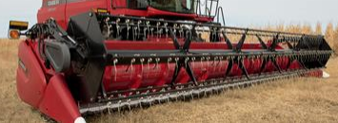
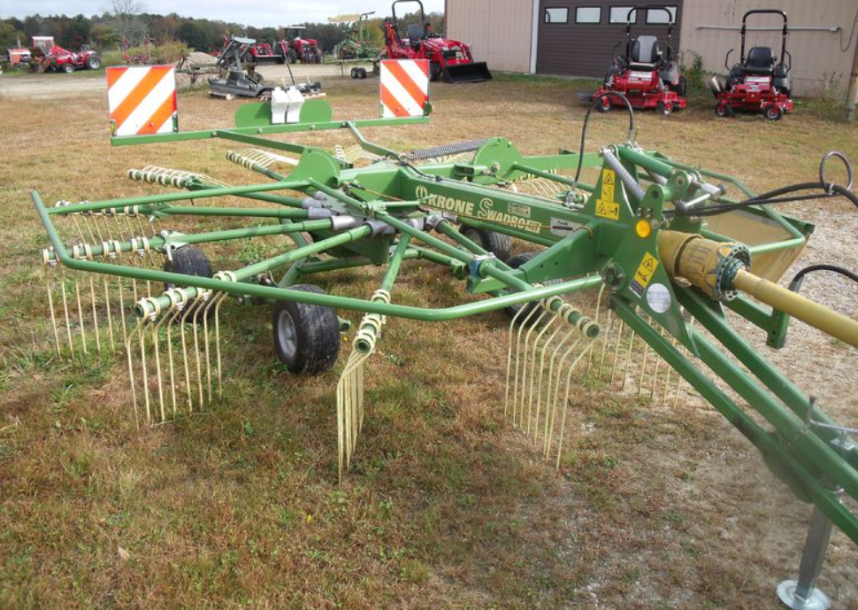
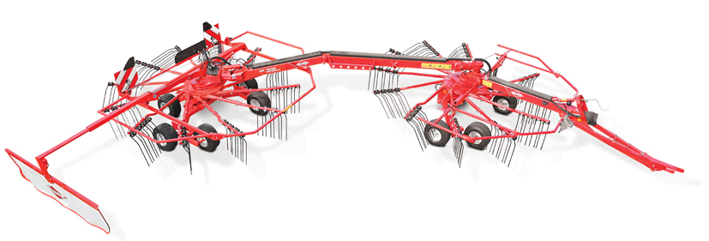
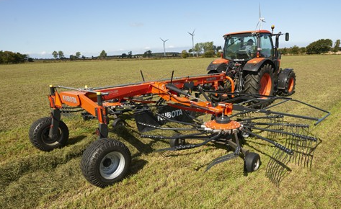
Combine Platform, Flexible Frame (FEPX)
AESC PRODUCT DEFINITIONS
A crop gathering unit for combines designed to collect and transfer crop into the threshing area while following ground contour allowing for close gathering of a crop that has grain heads or seed pods close to the ground.
Reporting classifications: by cutting width of crop area in feet
Rotary Rakes (FERO)
Rotary Rake: A machine pulled by or mounted on an agricultural tractor, either ground drive, driven by the tractor PTO, or by the tractor hydraulics. Primarily used to move crop material from one location to another, generally in a windrow, turning the crop to facilitate the drying and to prepare the crop for final processing. Process consists of one or multiple horizontally positioned rotors with multiple tine bars and tines that sweep cut crop, positioning it into a windrow.
Reporting classifications: by number of rotors

Slide 25
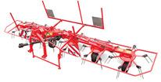
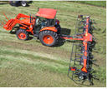
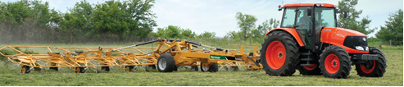
Tedders (FETD)
AESC PRODUCT DEFINITIONS
A detachable/interchangeable unit which, when attached to a self-propelled windrower power unit, cuts hay, forage or specialty crops by means of a reciprocating knife within a cutter bar and a pickup or bat reel. Cut crop is conveyed to the opening by augers. The header deposits the cut or conditioned crop in a swath or windrow on the ground behind the unit. Crop can pass through horizontally positioned conditioning rolls.
Reporting classifications: by working width in feet

Slide 26
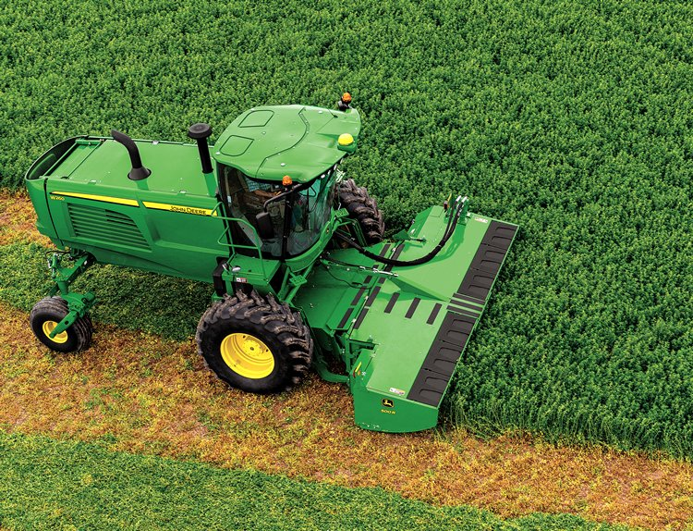
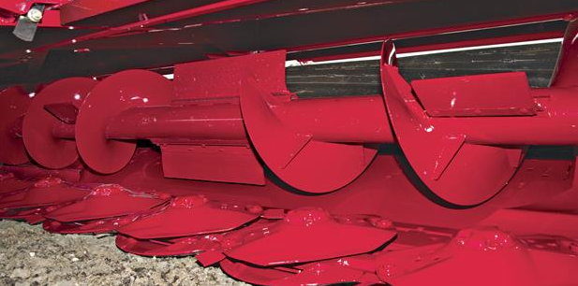
AESC PRODUCT DEFINITIONS
Windrower/Swather Heads – Disk
(self-propelled) (FEW2)
A detachable/interchangeable unit which, when attached to a self-propelled windrower power unit, cuts hay, forage or specialty crops by means of a series of rotating disks, each holding multiple knives. Cut crop may or may not be conveyed to the opening by augers. The header deposits the cut or conditioned crop in a swath or windrow on the ground behind the unit. Crop can pass through horizontally positioned conditioning rolls.
Reporting classifications: by cutting width of crop area in feet

Slide 27
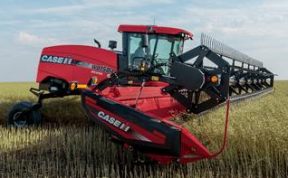
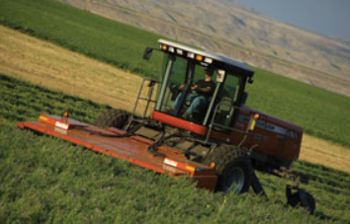
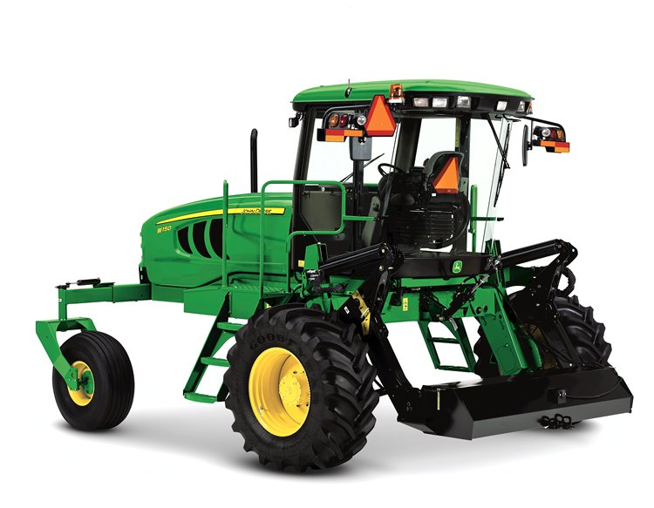
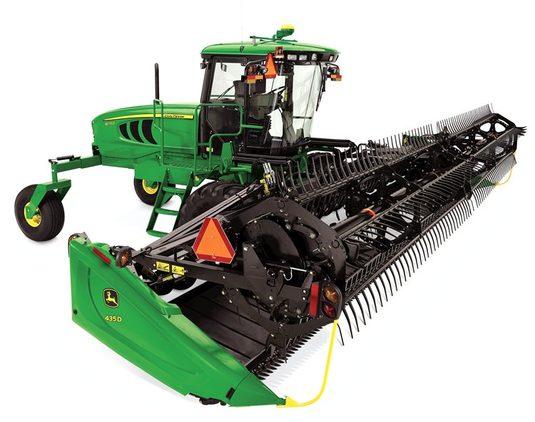

Windrower, Self-Propelled (FEW3)
AESC PRODUCT DEFINITIONS
A self-propelled machine with a separate cutterbar or rotary/disk header attachment for windrowing, swathing or conditioning grain, hay, forage or specialty crops.
Reporting classifications: by engine horsepower
Windrower/Swather Heads – Draper Type (self-propelled) (formerly Canvas Type) (FEWC)
A detachable/interchangeable unit which, when attached to a self-propelled windrower power unit, cuts grain, hay, forage, or specialty crops by means of a cutting device. Cut crop is conveyed to the opening by a rubber-coated draper. Head deposits the cut crop in a swath or windrow on the ground behind the unit.
Reporting classifications: by cutting width of crop area in feet

Slide 28
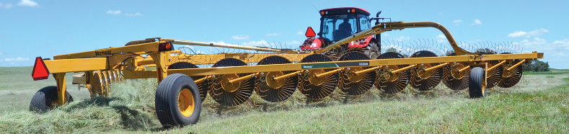
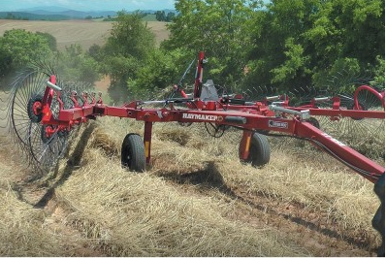
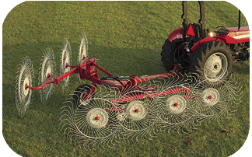
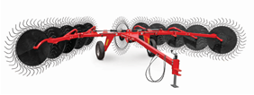
Rake, Finger Wheel (FEWR)
AESC PRODUCT DEFINITIONS
A machine pulled by or mounted on an agricultural tractor. This machine can be driven by the tractor PTO, by the tractor hydraulics or ground drive. It is primarily used to move cut crop material from one location to another location, generally into a windrow, turning the crop to facilitate drying of the material and to prepare the material for final processing. Process consists of a series (2,3,4,etc.) of wheels with finger tines encompassing the circumference of the wheel. The wheels are ground driven and run at an angle to the direction of travel so as to move crop material. These wheels are either mounted on a single toolbar creating a windrow to one side of the toolbar, or on two toolbars in a V-configuration to pull material into one windrow at the center of the rake.
Reporting classifications: maximum raking width in meters

Slide 29
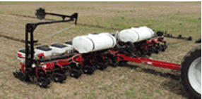
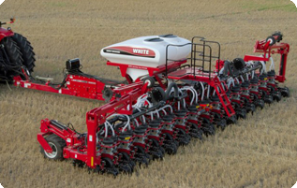
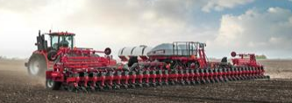
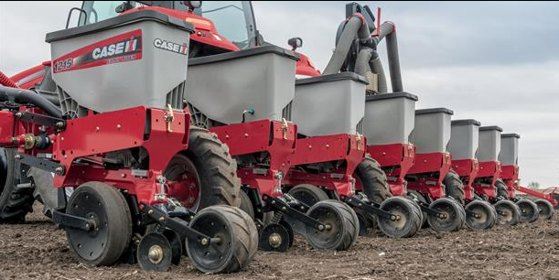
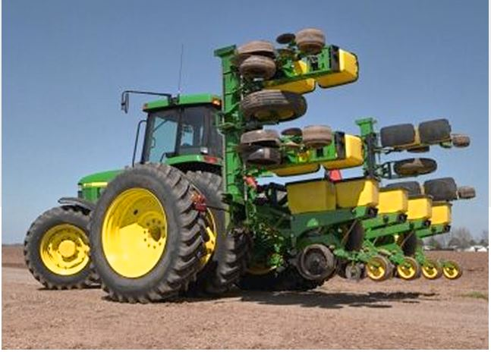
Planter, Pull Type (FE15)
AESC PRODUCT DEFINITIONS
“Crop Production Equipment” Product Line
A Pull type planter is a serialized frame member that supports multiple row units, and is towed via a pivoting connection at a draw bar or 2-point hitch.
Reporting classifications: by number of rows and unit design. Twin row planters will be reported as one row unit for each unit twin row. For example, a 36-twin-row unit, planting 72 rows will be reported as 36 rows.
Reporting classifications: by number of rows and unit design
Planter, Mounted (FE16)
A Mounted planter is a serialized frame member that supports multiple row units and must be rigidly mounted via a 3-point hitch. Twin row planters will be reported as one row unit for each twin row unit. For example, a 36-twin-row unit, planting 72 rows will be reported as 36 rows.
Reporting classifications: by number of rows and unit design

Slide 30
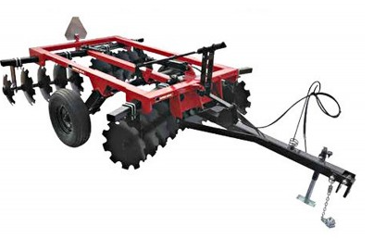
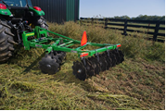
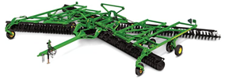
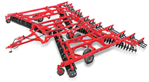
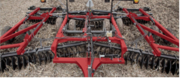
AESC PRODUCT DEFINITIONS
Light Duty Disk Harrow (FE57)
A light duty implement consisting of gangs of concave disks in either offset or tandem configuration. Adjustment of gang angle controls cutting aggressiveness. Disk harrow hitches are either rear 3-point mounted or pull-type and less than 10 feet.
Reporting classifications: by working width in feet
Pull-Type Disk Harrow (FE58)
A primary or secondary tillage implement consisting of gangs of concave disks arranged in a tandem configuration. Adjustment of gang angle controls cutting aggressiveness. Disk harrow hitches are only pull-type and 10 feet & Over.
Reporting classifications: by working width in feet

Slide 31
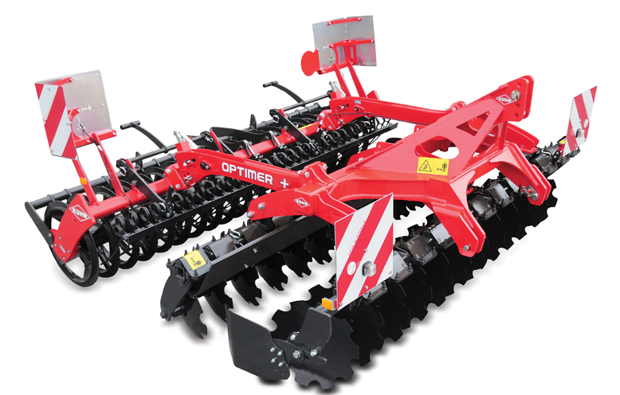



AESC PRODUCT DEFINITIONS
Compact Disk (FECD)
The Compact Disk is a primary or secondary tillage implement consisting of two parallel gangs of concave disks. Disk blades are mounted individually with compound angles to the direction of travel.
Reporting Classifications: by width of cut in feet
Rotary Tillers (FER5)
A rear-mounted, PTO driven tractor attachment with a series of blades mounted on a power driven shaft, used to break up soil. Units can be gearbox or chain driven and are used for primary or secondary tillage.
Reporting classifications: by working width in inches

Slide 32



Sprayer, Power (high-clearance) (FESP)
AESC PRODUCT DEFINITIONS
A self-propelled machine used primarily in the application of pre- and post emergent pesticides, herbicides, fungicides and fertilizers on row or solid seed crops. The chassis is designed with a minimum or 36 inch crop clearance to pass through crops without causing unacceptable damage. The chassis must be able to operate in liquid applications and can be used in dry/granular applications. For dry/granular application, the product is contained in one or more bins and may be applied accurately to the crop or ground using either a broadcast spinner spreader or pneumatic applicator equipped with booms and appropriately spaced distribution outlets. With liquid product, the solution is contained in one or more tanks and is sprayed accurately on the crop by delivering a solution through a manifold to appropriately spaced nozzles. The nozzles are at a right angle outward from both sides of the chassis, usually parallel to and set distance from the ground.
Reporting classifications: Liquid Capacity (Gallons)

Slide 33

Strip Tillage (FEST)
AESC PRODUCT DEFINITIONS
Strip till machines are designed to till a specific strip of soil a few inches wide in the direction of travel. This strip can be any depth and width as long as each strip leaves an unworked strip of soil between the row unit. The purpose of a strip till machine is one pass tillage and possibly fertilizer application to prepare a seedbed for later planting. It is not full-width, or broadcast tillage where the entire acre of soil is prepared the same. It combines the benefits of no-till management between the strips and greater tillage following each row unit. These machines are not self-propelled.
Reporting Classifications: Sized by Total Number of Rows
Air Delivery System (TPA3)
An air delivery system consists of one or more holding tanks for seed and fertilizer. Beneath the tanks are metering systems that drop the products into an air stream created by a fan mounted on the air seeder. The airflow carries the metered product through a distribution system to some form of ground engaging implement. This category should not include any ground engaging implements such as an air hoe drill or a tillage implement. If the sale being reported includes an air seeder and a light duty cultivator, then the sale should be broken down into the two categories affected
Reporting classifications: tank capacity in bushels

Slide 34
AESC PRODUCT DEFINITIONS
Air Hoe Drill (TP14)
A seeding implement that has on-row depth control and packing. Openers may be mounted on an opener assembly that have individual depth control by adjusting the relative position of the packer wheel to the opener. Air flow is being used to distribute seed to the opener. OR
Openers may be mounted on a "c"-shank, edge-on shank or hoe shank. Air flow is being used to distribute seed to the opener. The depth control for the implement must be maintained by the front castor wheels and the rear on-row packing wheels. The individual opener assembly depth control is the main criteria differentiating a Hydraulic Trip Air Hoe Drill from a Standard Air Hoe Drill with depth controlled by the front castor wheels and the rear on-row packing wheels. The depth control is the main criteria differentiating an air hoe drill from a tillage implement with mounted packer wheels. A tillage implement has wheels within the frame to control the depth of the openers. It is recommended that this category include seeding implements with either knife openers or sweeps.
Reporting classifications: based on working width in feet

Slide 35

Air Disc Drill-Integrated (TP12)
AESC PRODUCT DEFINITIONS
This seeding or banding implement utilizes a disc ground engaging system to create an opening in the soil for seed placement. The implement may use a single disc or a double disc to create the seed trench. Air flow is being used to distribute the seed to the disc opener. There must be a differentiation between a disc drill and a hoe drill that has coulters mounted in front of the shanks to cut through heavy crop residue. The main criteria for an air disc drill should be that the disc creates the opening for seed placement. The seed is carried in a tank system that is integrated and mounted to the frame of the implement such that it is not easily removed and used for other applications. The tank system does not have a separate serial number.
Reporting classification: Based on working width in feet

Slide 36

Air Disc Drill-External (TP13)
AESC PRODUCT DEFINITIONS
This seeding or banding implement utilizes a disc ground engaging system to create an opening in the soil for seed placement. The 24 implement may use a single disc or a double disc to create the seed trench. Air flow is being used to distribute the seed to the disc opener. There must be a differentiation between a disc drill and a hoe drill that has coulters mounted in front of the shanks to cut through heavy crop residue. The main criteria for an air disc drill should be that the disc creates the opening for seed placement. The seed is carried in a separate tow behind or tow between cart that is attached to the machine via a hitch mechanism. The cart has a separate and independent serial number which is counted in the TPA3 category.
Reporting classification: Based on working width in feet

Slide 37


Plows, Moldboard (TP53)
AESC PRODUCT DEFINITIONS
A primary tillage implement which cuts, partially or complete inverts a layer of soil to bury surface materials and pulverizes the soil. The part of the plow that cuts the soil is called the bottom or base. The moldboard is the curved plate above the bottom which receives the slice of soil and inverts it. Moldboard plows are equipped with one or more bottoms of various cutting widths. Bottoms are commonly right-hand that turn all slices to the right. Two-way moldboard plows are equipped with right-hand and left-hand bottoms that are alternately used to turn all slices in the same direction as the plow is operated back and forth across the field.
Reporting classification: 2-Way Mounted and 2-Way Semi-Mounted.
Plow, Combination Chisel (TPCC)
Combination of two implements consist of leading flat or concave disks or individual rolling coulters to cut surface residue and vegetation followed by chisel plow shanks. Chisel plows differ from cultivators by being constructed stronger with wider spaced shanks for primary tillage generally deeper than 8” of operation.
Reporting classification: Based on working width in feet

Slide 38



Plows, Chisel (TPCP)
AESC PRODUCT DEFINITIONS
A primary implement which shatters the soil without complete burial or mixing of surface materials. Multiple rows of staggered curved shanks are mounted either rigidly or with resets. Interchangeable sweep, chisel, spike, or shovel tools are attached to each shank. Working width is increased by adding folding wings to the main unit. Not "V" type or subsoilers. Chisel plows differ from cultivators by being constructed stronger with wider spaced shanks for primary tillage.
Reporting classifications: by design type and working width in feet
Cultivator, Field (pull-type) (TPFP)
A pull-type secondary tillage implements for seedbed preparation, weed eradication, or fallow cultivation subsequent to some form of primary tillage. Field cultivators are equipped with spring steel shanks or teeth which have an integral forged point of mounted holes for replaceable shovel or seep tools. Teeth are generally spaced up to 23 cm (9 in.) in staggered pattern. Frame sections are folded updates are backwards for transport.
Reporting classifications: by working width in feet

Slide 39

Three (3) Point Mounted Drills (TPG1)
AESC PRODUCT DEFINITIONS
3-point mounted drills are grain drills designed to work primarily in soil which has been previously tilled, which is mounted directly to the tractor 3-point hitch. Generally, the mounted grain drill is operated and transported while directly connected to the tractor 3-point hitch. Grain drills are designed to plant or seed coarse grains, feed grains, legumes, oil crops, grasses and other field crops in rows generally narrower than 15” spacing. Different than planters, seed metering is accomplished by volumetric rather than singulation seed metering devices. Grain drills may also be equipped with ancillary boxes to meter and apply fertilizer and other granular materials at the time of seeding
Reporting classifications: by working width in feet

Slide 40

Pull Type Rigid Drills (TPG2)
AESC PRODUCT DEFINITIONS
A pull type grain drill, designed to work primarily in soil which has been previously tilled, with one section which does not fold for transport. May have transport wheels on outside ends of the drill (often called an “end wheel grain drill”) or to the front or rear of the drill. Grain drills are designed to plant or seed coarse grains, feed grains, legumes, oil crops, grasses and other field crops in rows generally narrower than 15” spacing. Different than planters, seed metering is accomplished by volumetric rather than singulation seed metering devices. Grain drills may also be equipped with ancillary boxes to meter and apply fertilizer and other granular materials at the time of seeding.
Reporting classifications: by working width in feet

Slide 41

No-Till Drills (TPG3)
AESC PRODUCT DEFINITIONS
A grain drill, either 3-point mounted or pull type, which plants or seeds directly into previous crop residue without tillage. Different than grain drills operating in tilled seedbeds, no-till grain drills utilize separate residue and soil cutting coulters or heavier row units with residue and soil cutting capabilities. Seeding is accomplished with minimum soil residue disturbance. Grain drills are designed to plant or seed coarse grains, feed grains, legumes, oil crops, grasses and other field crops in rows generally narrower than 15” spacing. Different than planters, seed metering is accomplished by volumetric rather than singulation seed metering devices. Grain drills may also be equipped with ancillary boxes to meter and apply fertilizer and other granular materials at the time of seeding.
Reporting classifications: by working width in feet

Slide 42





Grain Drill, Folding (TPGF)
AESC PRODUCT DEFINITIONS
A grain drill (see grain drill definition) with two, three or more sections, which folds by hydraulic or mechanical means to a narrower transport width. Folding generally occurs in a horizontal plane and folds either forward or rearward.
Reporting classifications: by number of sections
Tillage, Minimum Primary (TPMP)
A primary tillage implement which shatters the soil without burial or mixing of surface materials. A machine utilizing one or more rows of shanks which mount on an "in-line" or "V-shaped" frame. This implement has a working depth of twelve inches or more below the soil surface. The design of this implement is to leave a percentage of crop residue on the soil surface to meet current federal minimum-tillage guidelines.
Reporting classifications: by working width in feet

Slide 43



Tillage, Combination Primary (TPTP)
AESC PRODUCT DEFINITIONS
A machine utilizing two (2) or more dissimilar tillage elements as integral parts of the base machine that displaces and shatters soil to reduce soil strength, and to bury or mix plant materials and fertilizers in the tilled layer. Primary tillage is more aggressive, deeper, and leaves a rougher surface relative to secondary tillage. Combination primary tillage (TPTP) tools differ from combination chisels (TPCC) in that the burying/mixing operation is made using a separate tillage element from that used to displace and shatter the soil (e.g., by using rows of concave discs). Combo Primary tillage is generally deeper than 8” of operation. TPCC machines do NOT fit in this category.
Reporting classifications: by working width in feet
Tillage, Combination Secondary (TPTS)
A machine utilizing two (2) or more dissimilar tillage elements as integral parts of the base machine (not as attachments) that is used for seedbed preparation and/or chemical incorporation and that works the soil to a shallower depth than primary tillage, provides additional pulverization, levels and firms the soil, closes air pockets, and kills weeds. Seedbed preparations are the final secondary tillage operation.
Reporting classifications: by working width in feet

Slide 44



Tillage, Vertical (TPVT)
AESC PRODUCT DEFINITIONS
Vertical tillage equipment consisting of two or more rows of blades (parallel or non-parallel rows, individual or gang mounted, straight coulters or shallow concavity blades), but with no compound blade angles to the direction of travel. Such equipment would not include horizontal tools such as sweeps or plow shares of any kind. This equipment (0-4” operating depth) is designed for seedbed preparation and near surface management of crop conditions in an effort to improve soil aeration, soil structure, aggregation, or tilth, and to enhance water infiltration residue sizing and decomposition, or to suppress weed growth.
Reporting classifications: by working width in feet
Note: Companies will receive county level reporting for programs they report into and have county level. Companies will receive state/province level reporting if they do not report into the product. For those products you must request a report from the Data Processor.

Slide 45



Receivers (PG01)
AESC PRODUCT DEFINITIONS
AG PRECISION GUIDANCE
Receivers provide position information to the guidance system using differential GPS corrections. Generally, three levels of accuracy are available: Submeter, decimeter, and RTK (centimeter/ sub-inch). Some receivers are strictly for sub-meter accuracy.
Steering Kits (PG02)
Steering kits enable either assisted or automated steering of the vehicle. Steering kits that are either field installed or dealer installed are to be reported. Integrated steering installed at the factory during the assembly of the machine should not be included.
Activation Upgrades (PG03)
However, most receivers in the precision ag market are upgradeable for various levels of system accuracy. Often, activations (or sometimes called “unlock codes” or “passcodes”) are available to upgrade a receiver from one accuracy level to another.
Displays (PG04)
Display units provide the visual interface between the precision guidance software that controls the machine steering and the machine operator. While displays provide other capabilities, such as equipment control, field mapping, or yield monitoring, all displays reported must be precision guidance capable for agricultural machines. Display models that have both integrated display and receiver functionality or a built-in receiver should be reported as both a display unit and a receiver unit. Reporting classifications for displays will be determined by screen size measure diagonally in inches.

Slide 46
FEEV (Ag Equipment Value)
AESC PRODUCT DEFINITIONS
Report the total dollar value of shipments (i.e., price paid by dealers or distributors) for all sales of agricultural equipment (whole goods and attachments) sold in the U.S. and in Canada. Do not include construction, utility, lawn and garden, consumer equipment or repair parts. Agricultural products not reported to AEM should still be included in this report.
Report the total dollar value of agricultural equipment parts shipped to dealers and company stores in the U.S. and Canada. Parts value is defined as the value of net sales. OEM parts sales are excluded. Competitive parts are available from more than one source. Non-competitive parts are available only from the original manufacturer.
Report U.S. sales in U.S. dollars and Canada sales in Canadian dollars.
Ag Annual Retail value
Report the total retail value of machines and attachments for “main products” at the time of settlement, by US and Canada. Value input is monthly with annual output
Note: Only companies that report Main Products are included in FEEV Ag Value totals

